Slide 1

Unidos En Alabanza US Tour 2026
“Para La Gloria De Dios”
Sponsorship & Donor Partnership Proposal
A National Worship Concert Tour

Slide 2
EXECUTIVE SUMMARY
Unidos En Alabanza is a national Christian worship concert tour designed to unite the body of Christ through music, faith, and the proclamation of God’s word. This tour brings together world-renowned Christian Artists and worship ministries, attracting thousands of attendees per city and millions of followers across digital platforms. We invite sponsors and donors to partner with us in creating powerful worship experiences that glorify Jesus Christ, strengthen faith, and bring communities together under one roof across the U.S
2. OUR VISION
To see the Church united as one body, lifting one voice in worship to glorify God and advance His kingdom across the United States. Unite believers across denominations and cultures to Glorify God through anointed worship experiences
3. THE WORSHIP EXPERIENCE
Unidos En Alabanza features live performances by internationally recognized Christian Artists and worship groups including: Barak • Miel San Marcos • Lilly Goodman • Christine D’Clario • Alex Campos • Evan Craft • Ingrid Rosario • Un Corazón and many more. Each event is a high-quality, faith-centered production combining worship, prayer, testimony, and community fellowship—drawing thousands of attendees and engaging millions online. Each event is a high quality, faith centered production combining worship, prayer, testimony and community fellowship. Drawing thousands of attendees and engaging millions online

Slide 3
4. NATIONAL REACH & AUDIENCE
Multi City U.S Tour - Families, young adults, churches and faith-based communities. Millions of followers, strong digital engagement and social sharing. Partnerships with local Churches and ministries, heavy Marketing, Sponsors will gain access to a faith driven event and values aligned audience with high trust and engagement
WHY PARTNER WITH US UNIDOS EN ALABANZA
By becoming a sponsor or donor, you will:
• Align your brand or ministry with a Christ-centered mission
• Support worship experiences that transforms lives
• Gain visibility across live events, digital platforms, and marketing campaigns
• Reach a loyal, values-based Christian audience
6. SPONSORSHIP & DONOR OPPORTUNITIES
• Naming recognition alongside UNIDOS EN ALABANZA (Sponsor presents title)
• Prominent logo placement on stage, digital screens promotion and all marketing
• Verbal sponsor recognition during live events
• Digital promotion across tour platforms
• VIP access, meet & greet and hospitality
• Opportunity to address audience or provide ministry materials

Slide 4
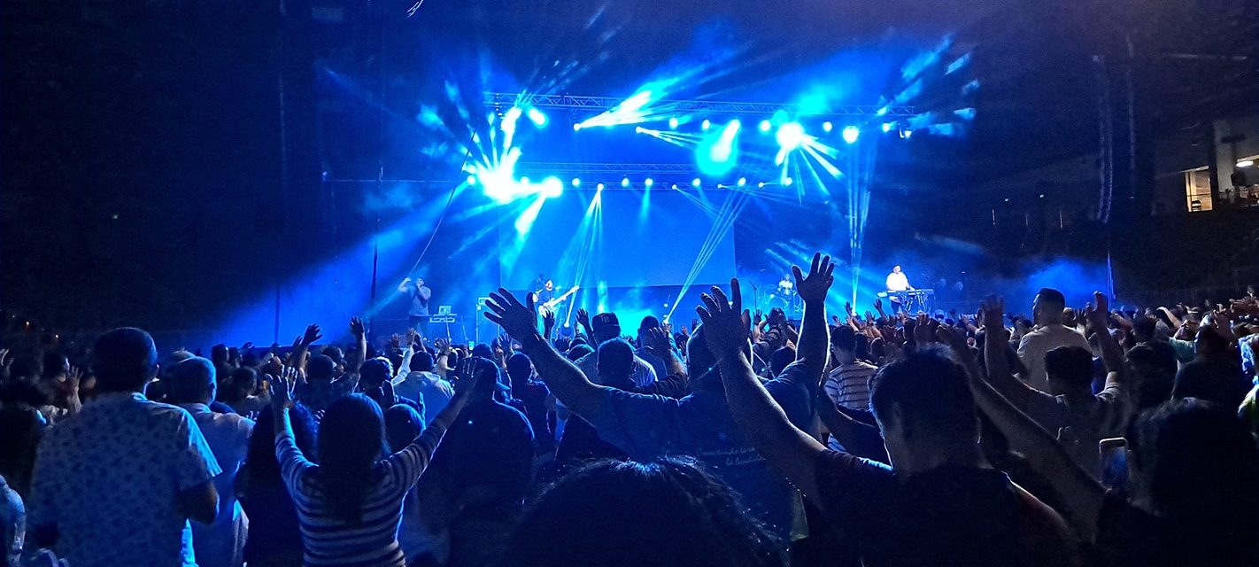
SPONSOR OUR WORSHIP TOUR
PRESENTING OUR
GOLD / SILVER / PLATINUM SPONSOR PACKAGES

Slide 5





SPONSORSHIP PACKAGES:
• Silver Sponsor - $1,500
• Gold Sponsor - $2,500
• Platinum Sponsor - $5,000
• Donor Kingdom Partner- For individuals, churches, or organizations who desire to give towards the mission without commercial branding: Recognition as a Kingdom Partner (optional), impact reports and testimonies, private prayer and appreciation gatherings, eternal investments in advancing worship and unity
2. SMALL BUSINESS SPONSORSHIP OPPORTUNITY
• Logo placement on flyers & posters, included in all event promotions ($500)
• Booth placement in lobby, introduce your business to thousands of potential customers ($1000)
• An opportunity for recognition throughout multiple cities and expand your brand

Slide 6
SUPPORTING SILVER SPONSOR: ($1,500)
• Prominent logo placement on flyers, posters and mechanizing
• Booth placement at lobby entrance /2 free tickets/2 all access passes/Website recognition/Event signage
SUPPORTING GOLD SPONSOR: ($2,500)
• Prominent logo placement on flyers, posters and mechanizing
• Booth placement at lobby entrance /6 free tickets/4 all access passes/Website recognition/Event signage
SUPPORTING PLATINUM SPONSOR: ($5,000)
• Naming recognition alongside UNIDOS EN ALABANZA (Sponsor presents title)
• Booth placement/10 free tickets/6 all access passes/Website recognition/Event signage
• On Stage Digital screens promotion, company banner on stage presence
• VIP access, meet & greet and hospitality, Verbal sponsor recognition during intermission
• Prominent logo placement on flyers, posters, mechanizing & opportunity to address the audience

Slide 7

MEASURABLE IMPACT • Thousands gathered in worship per city • Lives touched, faith renewed, and hope restored • Millions reached digitally • Churches united across regions “Let everything that has breath praise the Lord” – Psalm 150:6 CALL TO PARTNERSHIP We invite you to prayerfully consider partnering with UNIDOS EN ALABANZA as a sponsor or donor. Together, we can lift the name of Jesus Christ, unite the Church, and leave a lasting spiritual impact across our nation. One Nation. One Church. One Voice in Worship.

Slide 8
Contact: Charlie Jimenez / Brenda Ramos E: unidosenalabanza2021@gmail.com T: (305) 848-2577 / (954) 279-0742 W: www.unidosenalabanza.org
ORDER YOUR SPONSORSHIP PACKAGE NOW SPACES ARE LIMITED

